Slide 1
Design patterns
The Fluent Builder

Slide 2
usage
Provide a clear “fluent” way of creating a new member in a family of classes without directly exposing said classes' properties.

Slide 3

Example Scenario
For this scenario I have decided to go with a more geeky concept (forgive me)!
The client, in this case is a deity known as Dr Manhattan who can alter reality and wish things into existence! Dr Manhattan wants to build a universe of superheroes. However despite being omnipotent, he is still mostly a passenger to his own capabilities.
Therefore when Dr Manhattan creates a hero he doesn’t know exactly how these powers are created, he only knows to make them so.

Slide 4
Code Example

Slide 5

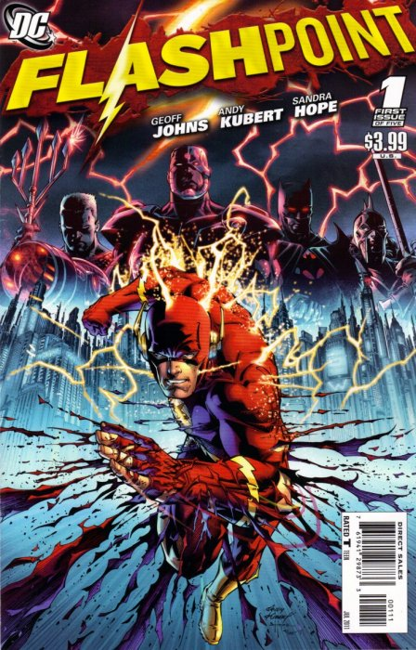


Good comics

